Slide 1
Representing Capabilities for Engineering Design
Dr. Tom Hagedorn
Professor Sundar Krishnamurty
Professor Ian Grosse
UMass Center for e-Design

Slide 2
Background
Capabilities are a fundamental part of engineering design
Key areas of concern:
Capabilities of a user
Capabilities of an organization
Capabilities as a source of value
Capabilities of manufacturing resources
Capabilities in product design
Capabilities of various stakeholders, machines restrict the design space
Preferences towards capabilities define design space

Slide 3


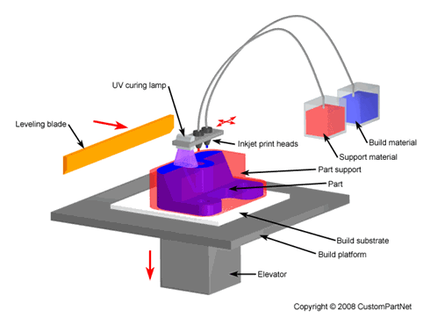
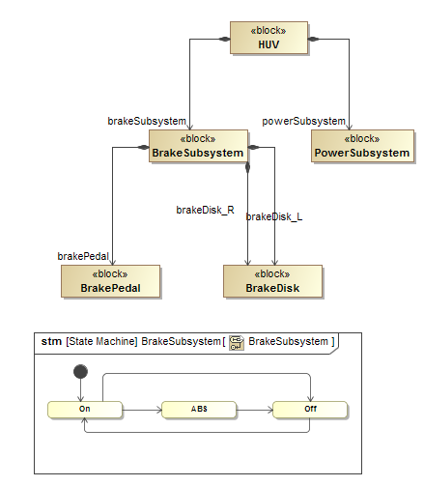

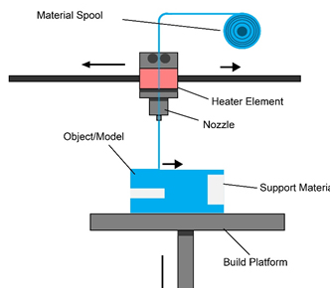


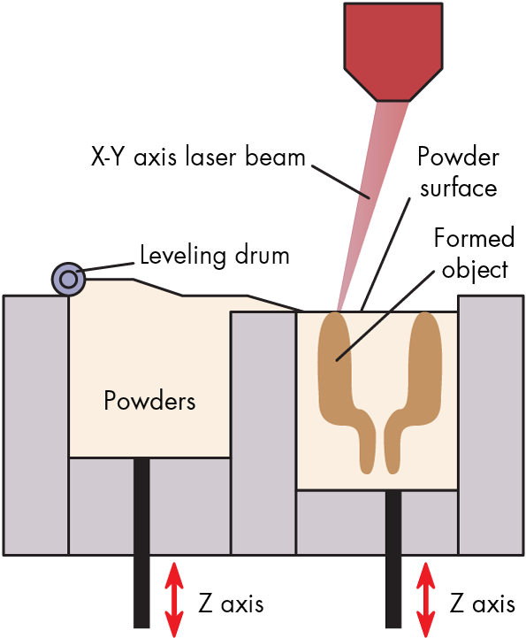

Specific Applications
Specification of a designs and modeling decisions
Human factors / Universal Design
Manufacturing
Design definition / Decision Making
http://www.mkstechgroup.com/polyjet-technology/
http://www.mkstechgroup.com/fused-deposition-modeling-fdm/
http://www.machinedesign.com/3d-printing/what-s-difference-between-stereolithography-and-selective-laser-sintering

Slide 4
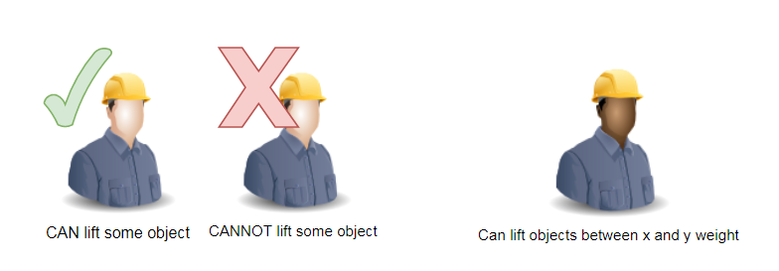
What is a capability
View capability as enabling participation in some process at some level of performance / success
Some level of restriction / refinement in practice
The process has some conditions or is completed in some way
Express in capability definition, or ICEs about the capability
Binary treatment
Continuous treatment

Slide 5
Applications: Innovation and Manufacturing
Consider capabilities from multiple perspectives
Do we (or some service provide) have the equipment to participate in a process?
Do certain machines have capabilities that allow the delivery of value to customers?
Can some specific manufacturing tool or machine fabricate a design as specified?

Slide 6
Product Value
Derived from traits born by a product
Traits inhering in the product itself
Enabling capabilities for stakeholders
Having certain capabilities might allow the creation of value
Provide services, create products, allow participation in useful or enjoyable processes

Slide 7
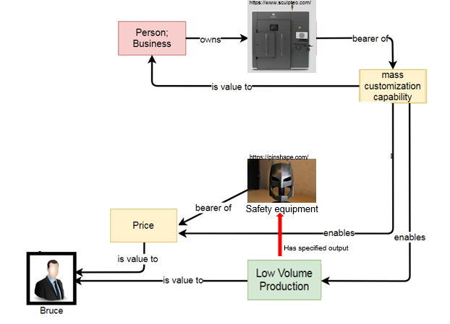
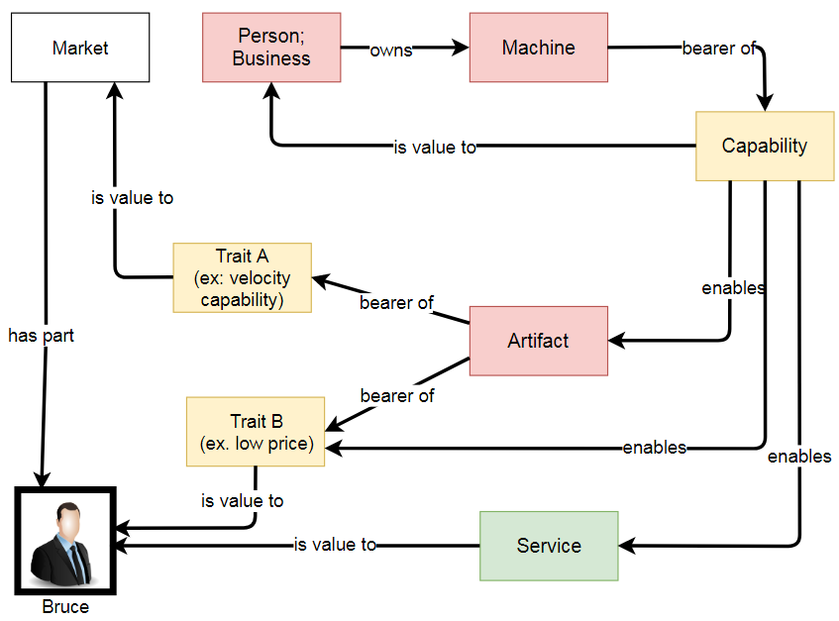
Product Value
How do certain resources contribute to the overall value of a product to stakeholders?
Important for defining product knowledge base

Slide 8
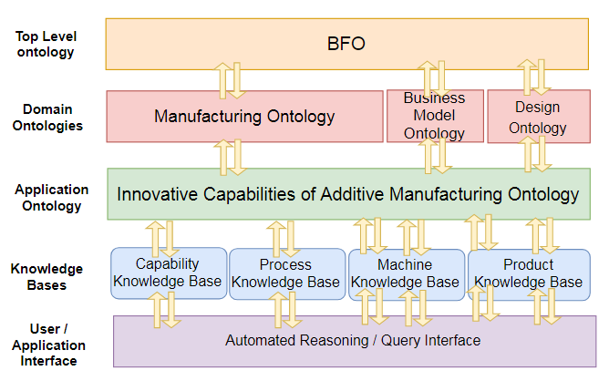
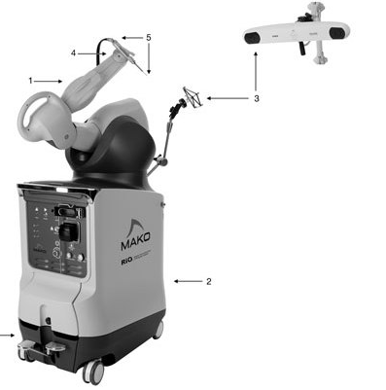
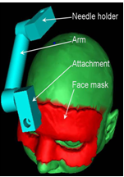
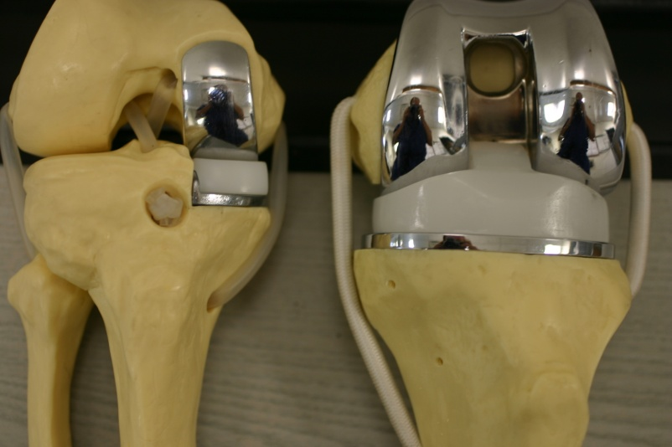
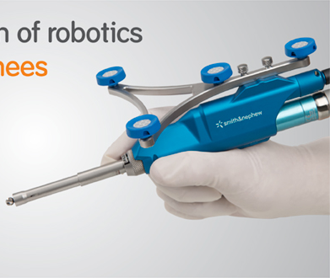
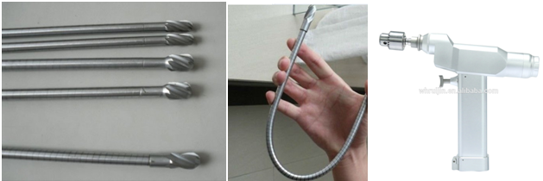
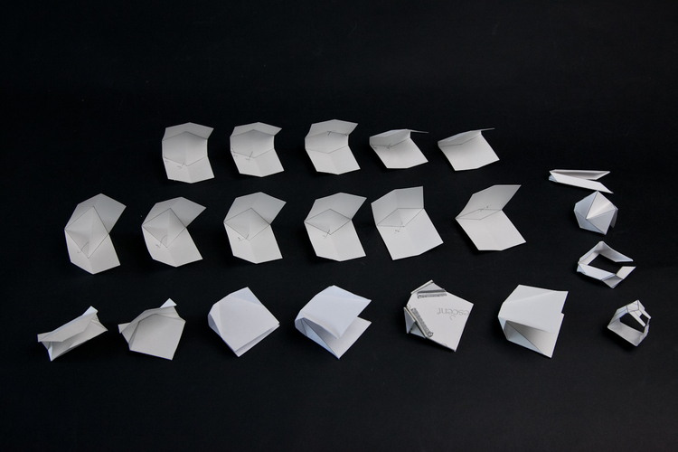
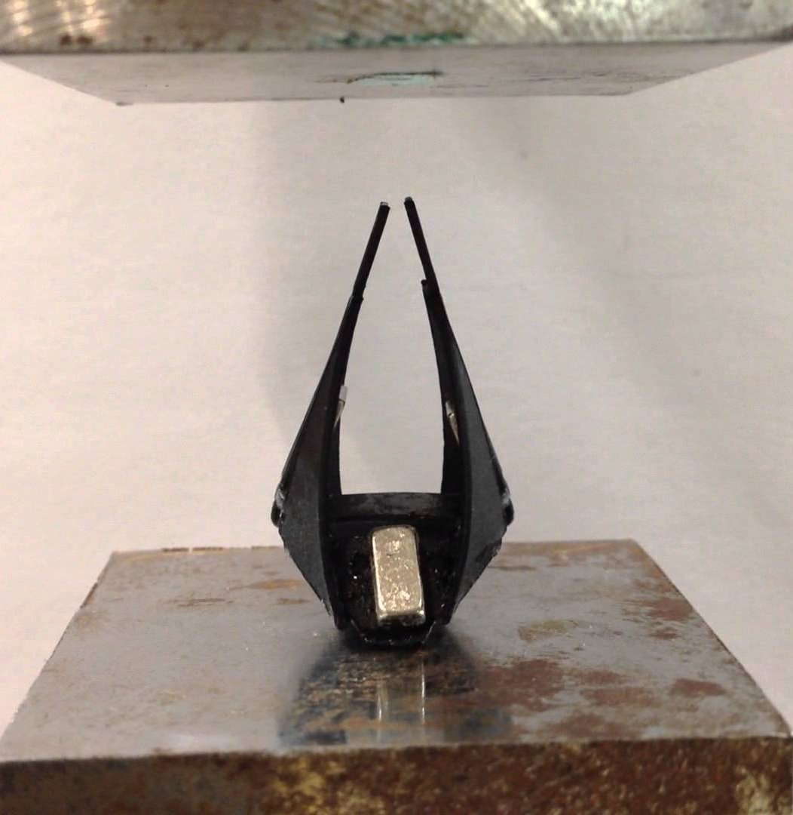
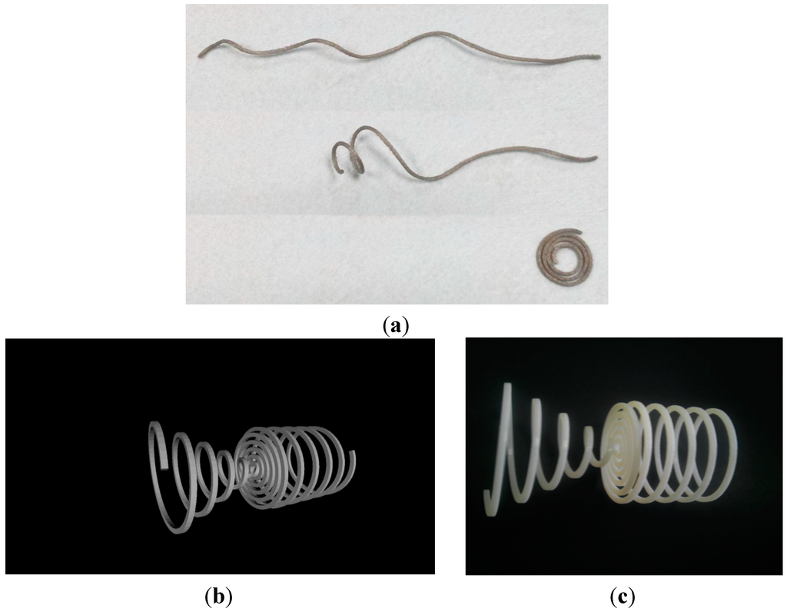
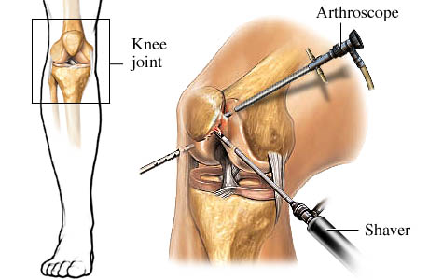
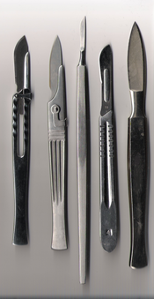
Linking to Specific Product knowledge
Used binary understanding of capability to map a knowledge base to an ontology
Combine with manufacturing knowledge, class hierarchy of “fabrication capabilities”, functional / engineering terminology
Implement a searchable ideation database
http://totalknee.org/patient-education/partial-knee-replacement/
http://www.smith-nephew.com/professional/microsites/navio/
https://www.wealthdaily.com/articles/this-robot-will-perform-your-next-surgery/6102
Rajon, D.A., Bova, F.J., Chi, Y.Y. and Friedman, W.A., 2009. Rapid fabrication of custom patient biopsy guides. Journal of Applied Clinical Medical Physics, 10(4), pp.260-272.
alibaba.com
https://www.youtube.com/watch?v=06III88xNqA
http://www.claytongrames.com/oriceps/
WebMD
https://en.wikipedia.org/wiki/Scalpel
Yang, W.G., Lu, H., Huang, W.M., Qi, H.J., Wu, X.L. and Sun, K.Y., 2014. Advanced shape memory technology to reshape product design, manufacturing and recycling. Polymers, 6(8), pp.2287-2308.

Slide 9
Key Insights
From a value perspective, many capabilities of interest are purely contextual
Manufacture in X environment
Switch jobs quickly and cheaply
Many capabilities are closely related to other traits
Possessing some combination of capabilities might imply possession of another
Traits like size, weight, price etc. might directly lead to other capabilities
Example: Desktop, distributed manufacturing
Gain some useful insights from a yes / no assessment of capability

Slide 10
Manufacturability
Manufacturability of parts, implications of design directly relate to machine capabilities
High level binary choice
Size scale? Meso? Micro? Nano?
Multi-material support? Unsupported? Makes some shape?
Wealth of specification information about manufacturing machines
Minimum Feature sizes (model number level)
“best” design practices (type of process level)

Slide 11
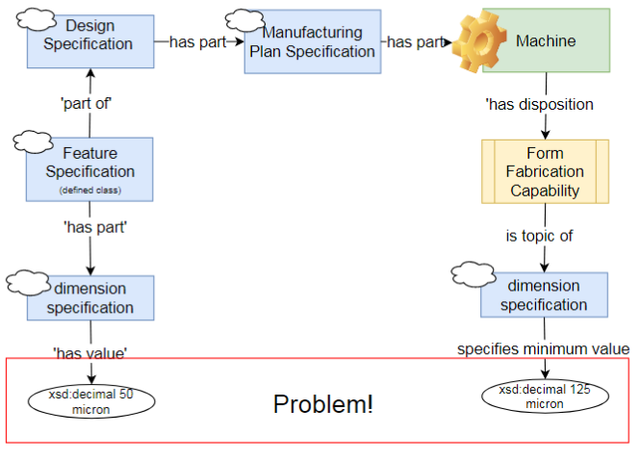
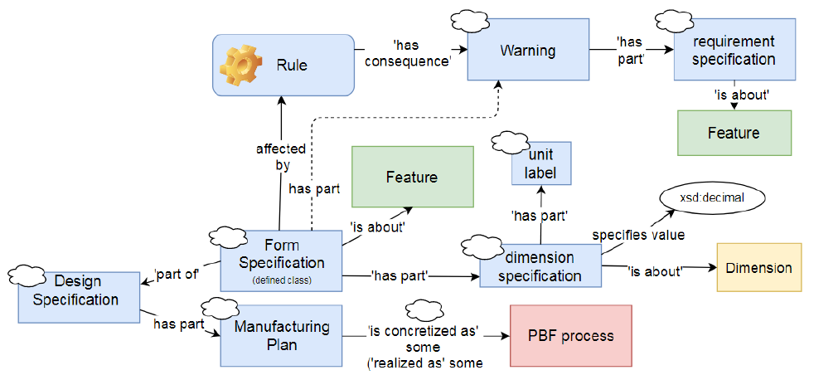
Manufacturability in an Ontology
Define “rules” affecting certain types of feature, manufacturing plan
is subject to
Use tools like SWRL or SPARQL to assess issues directly from tool specifications (e.g. from capabilities)

Slide 12
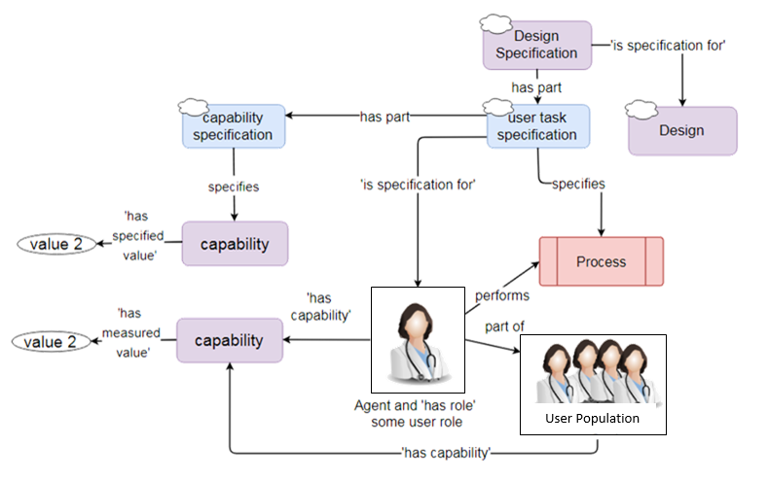
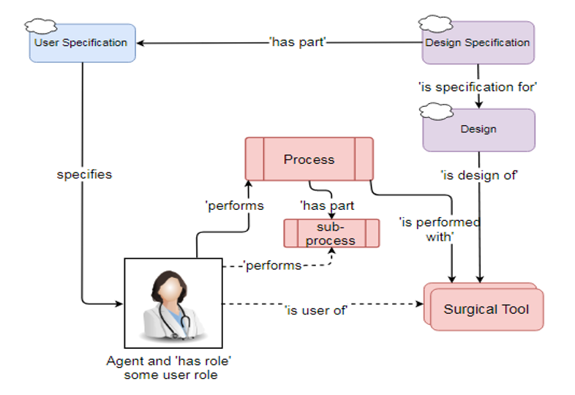
Extension to Usability Design
Used rule / query based treatment of capabilities useful across design domains
(simplified)
Consideration of requirements placed on user in context of expected capability
User in a process utilizing some design
Notes:
Of course, we have some trickiness trying to figure out how to characterize capabilities.
Simple case is things like reaches in certain planes, where we have well characterized anthropometric data

Slide 13
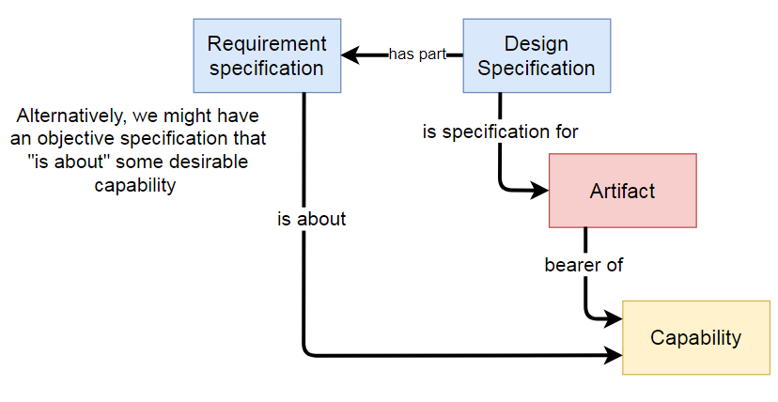
Capabilities in Design and Decision Making
Capabilities of artifact are often central to design and decision-making about design
Typically requirements are used to specify the set and acceptable range of capabilities based on stakeholder views

Slide 14
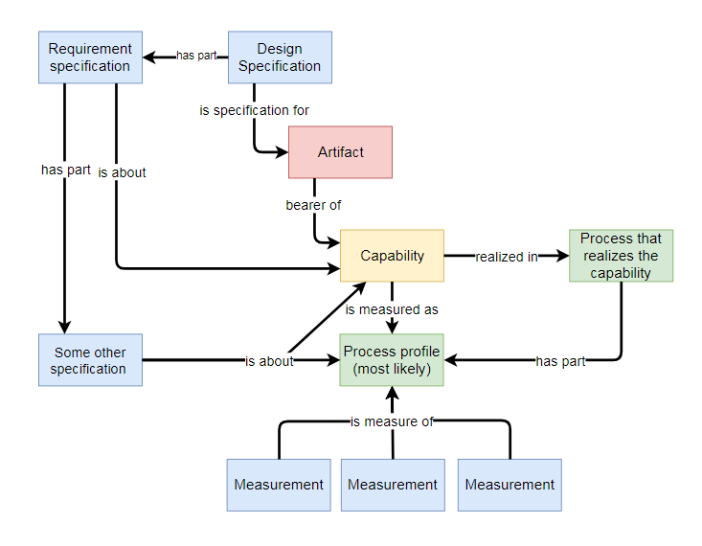
Characterizing Capabilities, Characterizing Designs
Might be many ways to characterize a capability
Many capabilities are not directly measureable
Specification of a design metric
Metric of the capability

Slide 15
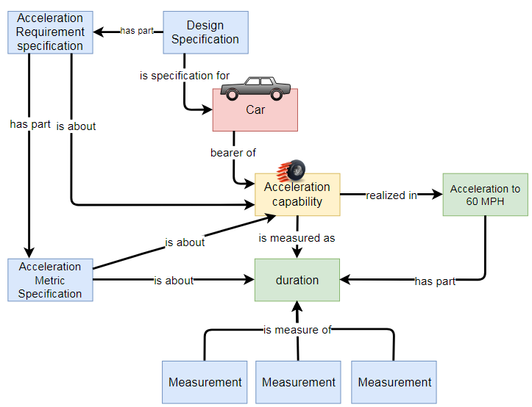
Characterizing Capabilities, Characterizing Designs

Slide 16
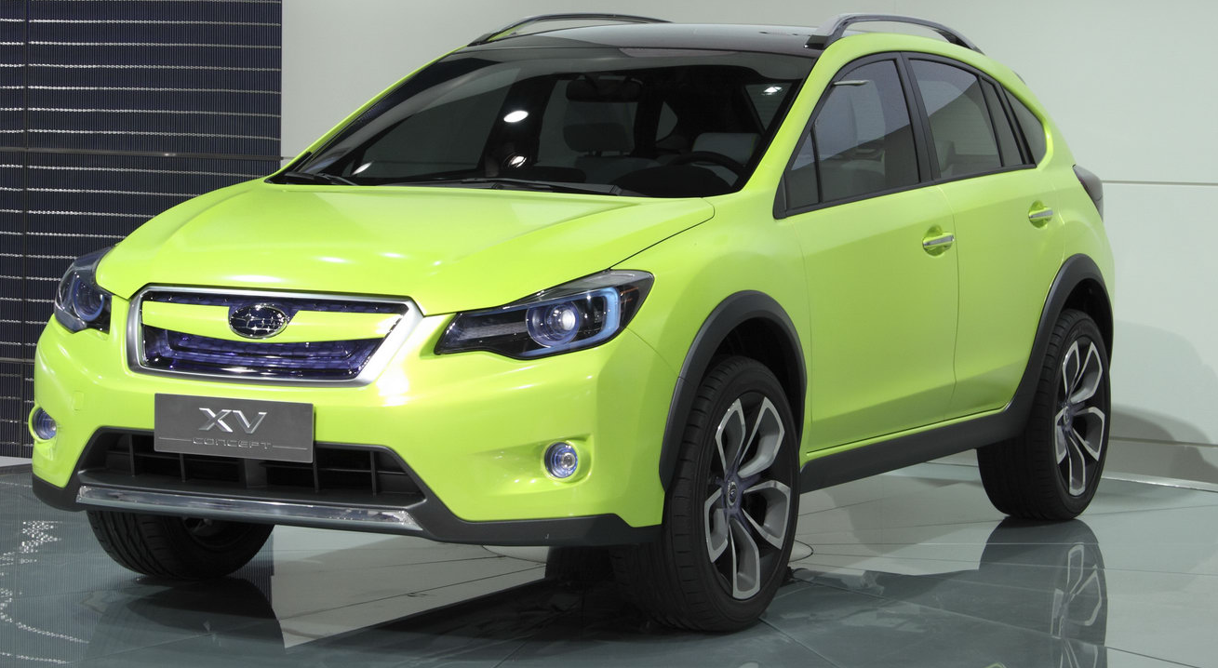
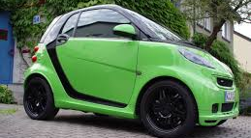
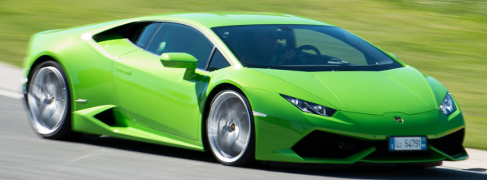
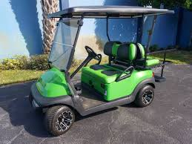
Use in Decision Making
Measurement alternative 1
Measurement alternative 2
Measurement alternative 3
https://todayautoreviews.wordpress.com/category/subaru/
http://hookupmycart.com/product/2016-club-car-precedent-lime-green-golf-cart-high-speed/
https://encrypted-tbn0.gstatic.com/images?q=tbn:ANd9GcRolBu5jXsCiNOj-_pozwLDx6C5kKCkRUNkXMDmaCNv3ZPQLCtKfA

Slide 17
Observations
This treatment very closely tracks common engineering design practice
Definition of customer requirements, assessment of “metrics” to characterize design “quality”
Much more challenging to create classes to support this type of model
Many domains,

Slide 18
Conclusions
Capabilities are central to ontologies of engineering design
Generally see two useful, overlapping characterizations of capability
High level definition of capability is usable in many engineering applications
Mainly an issue of defining subclasses of capability that are relevant to some field
Combined with information content entities can pretty intuitively express common engineering practice

